Slide 1

Cloud Based Student Information Chatbot Using AWS Lex
From: Guided by:
DHARVI PATEL & DHARMIL PRAJAPATI dr.amit thakkar
17it067 & 17IT086

Slide 2
OUTLINE
Motivation for choosing the project
Project Goal
Project description
Advantages & Disadvantages
Innovation in Project
Connection
Learning outcome
Further planning
References

Slide 3
Motivation for choosing the project
Cloud based student information Chatbot system is artificial algorithm that analyzes the student queries and reply as messages.
In this system artificial intelligence is built to answer the query of the student.

Slide 4
GOAL
This is very useful for the students who can not go college and also want the information about college.
Students can use the chat bot to get the answers to their questions.
Students can use these web based system for making queries at any point of time.

Slide 5
Project description
In this system artificial intelligence is built to answer the query of the student.
Answer are appropriate to the users queries if the user is invalid then it will notify the admin and same in answer, if answer is invalid then it will notify the admin.
Admin can view invalid through portal via login.
The System allows admin to delete the invalid answer or to add a specific answer of that equivalent question

Slide 6
Advantages
Students does not have to go personally to college office for the enquiry.
This application enables the students to be updated with college cultural activities.
This application saves time for the student as well as teaching and non-teaching staffs.

Slide 7
Disadvantages
Requires internet connection to upload the data.
Requires proper internet connection for the use the application.

Slide 8
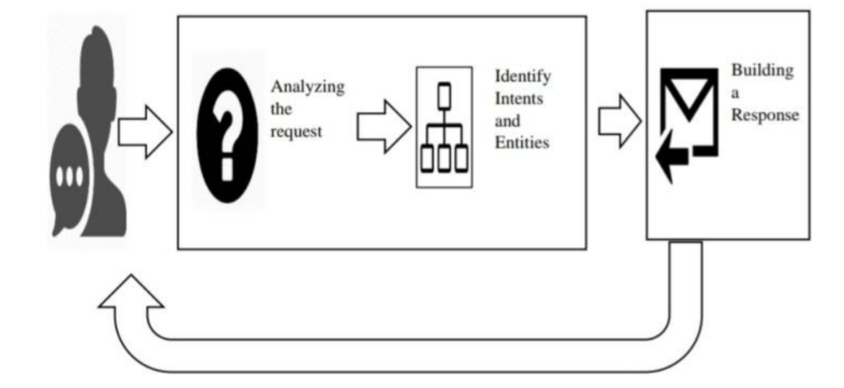
Flow of the Project
How to work Chat Bot

Slide 9
Tools and Technologies
AWS (Amazon Web Services)
AI(Artificial Intelligence)
MySql
PHP
Amazon Lex
Amazon Lambda
Amazon athena
Amazon S3

Slide 10
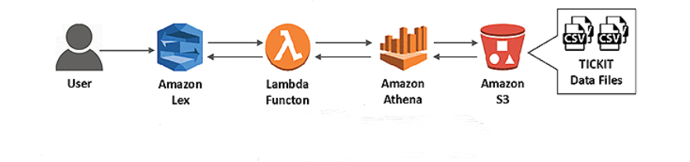
Connection

Slide 11
Future Enhancement
We add the more reliable factures in our project in next part.
We deploy application in next part of the project.

Slide 12
REFERENCES
https://aws.amazon.com/lex/
https://aws.amazon.com/blogs/machine-learning/building-a-conversational-business-intelligence-bot-with-amazon-lex/

Slide 13
Thank You

